Slide 1




CL - T3/2021
By,
D2i Geelong Squad

Slide 2




Project Overview
Aim
In 2015 Geelong City launched their Digital Geelong Strategy which aimed to guide the city efforts in becoming a clever and creative city region. ​
​
We will work with a representative from Geelong City Council to build and develop smart city initiatives, functioning as a melting pot for ideas and their rapid development.
International recognition of Geelong as ‘a clever and creative city-region that is forward looking, enterprising and adaptive, and cares for its people and environment’ by 2047.
Sub-team
1) Machine Learning
2) Data Visualization
3) Web Development

Slide 3




MACHINE LEARNING
DATA VISUALIZATION
WEB DEVLOPMENT
Kaiyuan Jiang (Senior)
Sahit Mantripragada (Senior)
Rakshith Rachenahalli Bettegowda (Senior)
Rao Siddhant Yadav (Senior)
Anugra Sara Thomas
Abdullah Abdulaziz M Algamdi
Saleh Mohammed M Alharbi
Rahul Kumar
Anyu Xu
Chris Chen

Slide 4

NAME
JR. / SR.
ROLE ASSIGNED
WORK DONE IN HOURS
TOTAL
ITERATION 1
ITERATION 2
TILL 04/12/21
RAO SIDDHANT YADAV
SENIOR
MACHINE LEARNING
46.2
68.1
114.3
RAKSHITH R BETTEGOWDA
SENIOR
WEB DEVELOPMENT
46.3
62.83
109.13
SAHIT MANTRIPRAGADA
SENIOR
DATA VISUALIZATION
44.3
75.16
119.46
KAIYUAN JIANG
SENIOR
MACHINE LEARNING
26
48
74
ABDULLAH A M ALGAMI
JUNIOR
WEB DEVELOPMENT
35.4
50.1
85.5
SALEH M M ALHARBI
JUNIOR
WEB DEVELOPMENT
34.2
48.8
83
ANUGRA SARA THOMAS
JUNIOR
MACHINE LEARNING
30.2
62
92.2
RAHUL KUMAR
JUNIOR
MACHINE LEARNING
36.5
71.6
108.16
ANYU XU
JUNIOR
DATA VISUALIZATION
27.1
73
100.1
CHRIS CHEN
JUNIOR
DATA VISUALIZATION
17
50.2
70.2

Slide 5
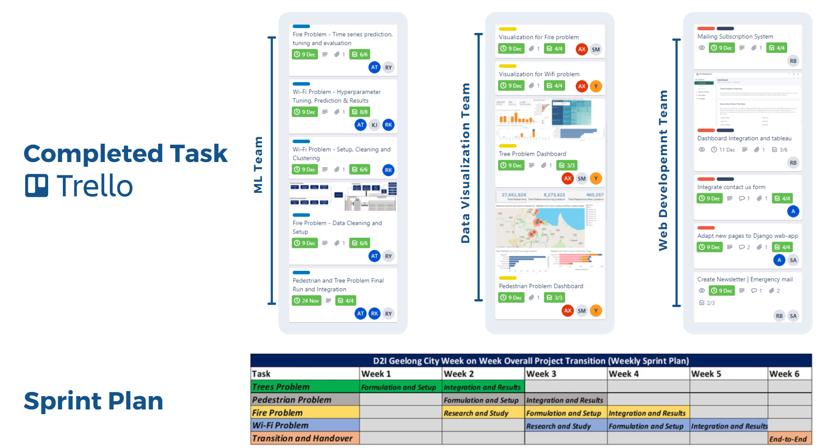

Slide 6


Unified Modeling Language
Tech Stack
Trees
Pedestrian
Fire
WI-FI
Machine Learning ​
Python - Google Colab Pro (For GPU options)
Prediction
Prediction
Data Visualization​
Tableau Server and Tableau Desktop​
Visualization
Visualization
Web development HTML5, Bootstrap, Php, JavaScript, SASS
Website - Dashboard

Slide 7


PROBLEM STATEMENT
TREES PROBLEM
PEDESTRIAN PROBLEM
A two part exercise that incorporates visualization related to trees at a suburb and tree type level and other relevant metrics, with prediction of tree on the basis of its features in Greater city of Geelong.​
To keep a track of citizen in Geelong city and types of places they have been to. This keeps track of citizen movement in restaurants, hospitals etc in post lockdown time in the city. We use Google API to get this information and monitor movement.​

Slide 8

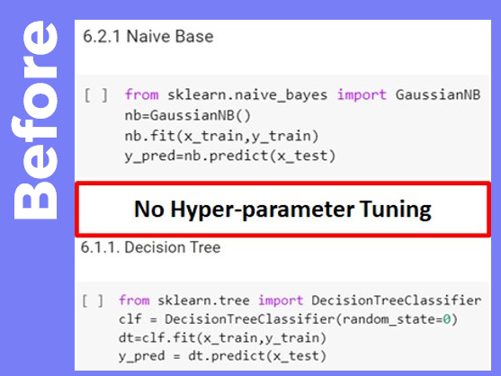

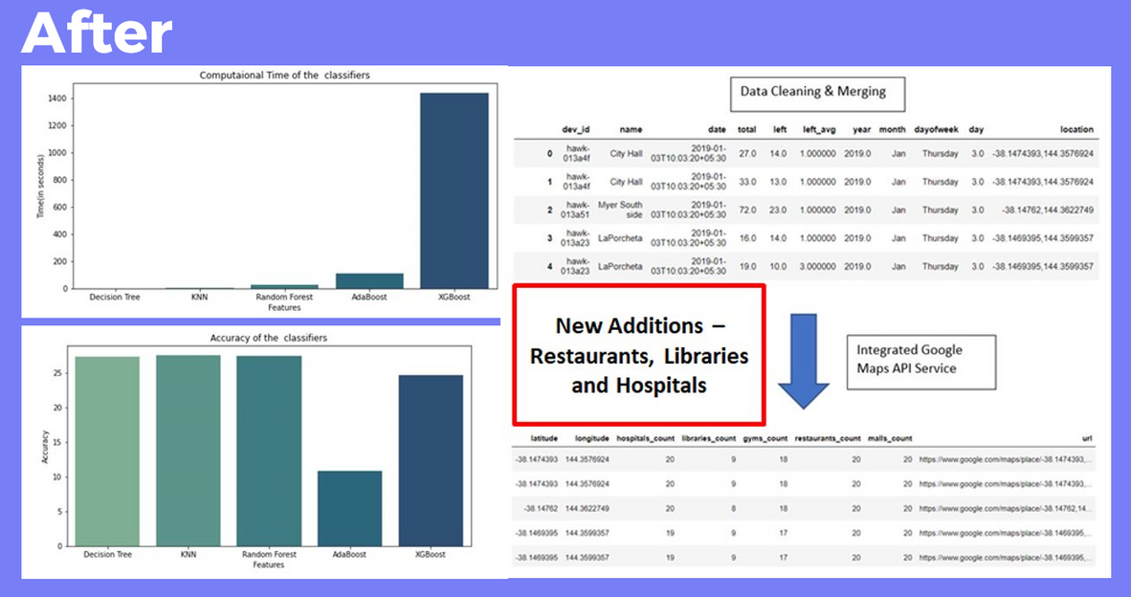

Tree and Pedestrian Results​
Improvements Tree Problem​
- Added over 5K samples by applying advanced imputing​
- Increased model prediction accuracy by over 2%​
- 5 algorithms, with hyperparameter tuning steps​
- Identified best model as Decision Tree on basis of run-time and accuracy​
​
Improvements Pedestrian Problem​
- Used Google API to add 4 more facility types in analysis​
- Lockdown stages vs Post for detailed comparative study​
​

Slide 9
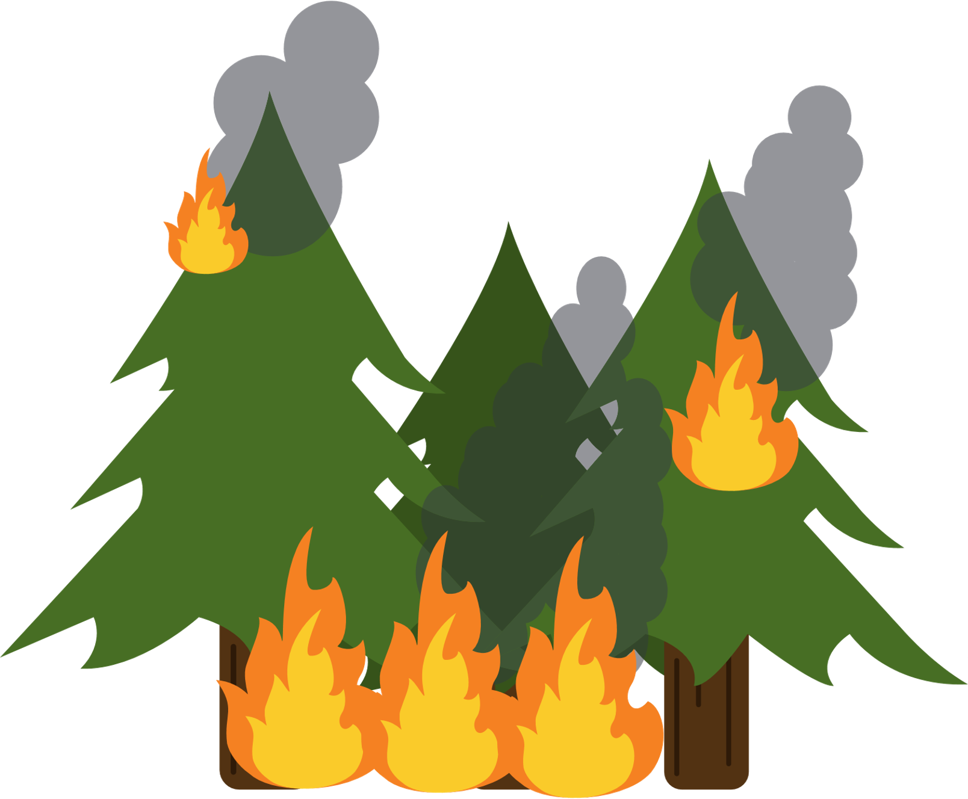

FIRE PROBLEM
WIFI PROBLEM
PROBLEM STATEMNET
Bushfires are an inconsistent hazard in Geelong City but it does create havoc when it affect the city. With high risk fire regions as close as 80km from Geelong, it is important to predict the possibility of fire in each Geelong and nearby suburb. Use time series prediction algorithms like LSTM, GRU and boosting algorithms​
With variable foot count in and around important hubs in Geelong City where free Wi-Fi is provided, it is important to know the foot count of users to increase/decrease router bandwidth or count as per usage. We plan to incorporate time series prediction exercises and MLP techniques for this task and check performance.

Slide 10
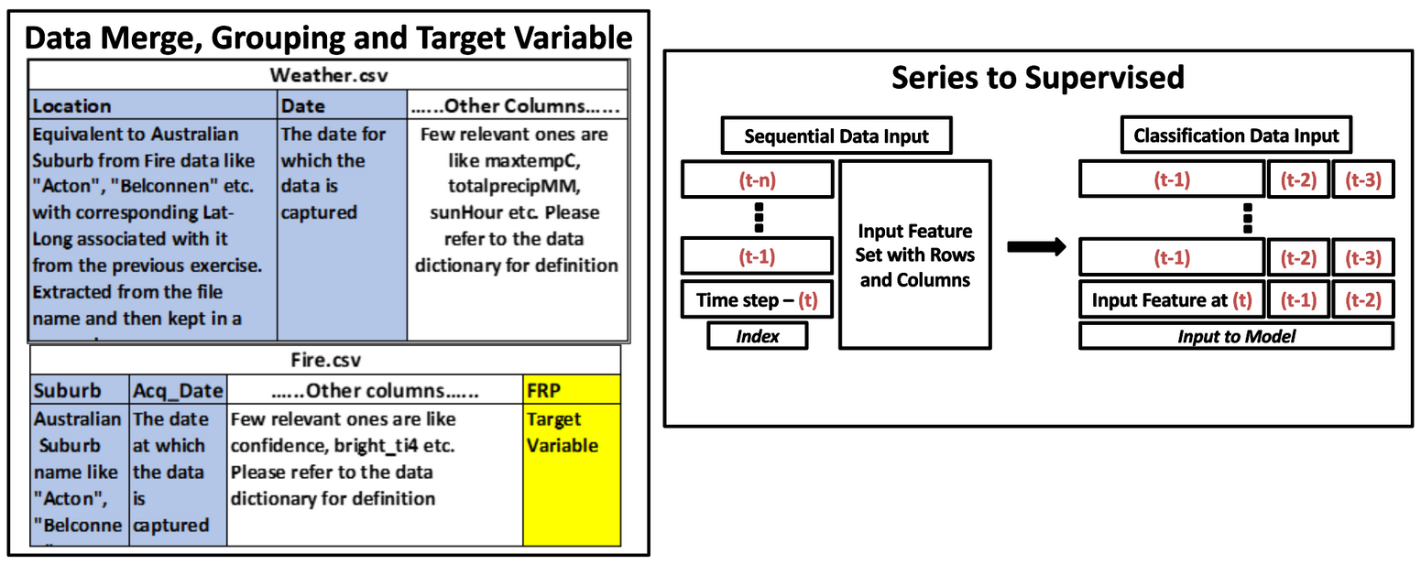

Processing Steps​
Merging Steps​
Prediction Steps​
Final Models​
- NASA VIIRS Fire and Weather Data
- Extraction​ Data Cleaning and Wrangling
- Reverse Geo-Coding​
- Grouping at Date-Suburb Level​
- Data Merge
- Class Definition​
- Class Balancing​
- Series to Supervised​
- Walkthrough​
- Input Weight
Handling
Neural Networks​
- Long and Short-Term Memory​
- Gated Recurrent Unit ​
- Simple RNN​
Boosting Algorithms​
- Random Forest​
- AdaBoost​
- Gradient Boosting​
- XGBoost​
Prediction Output

Slide 11
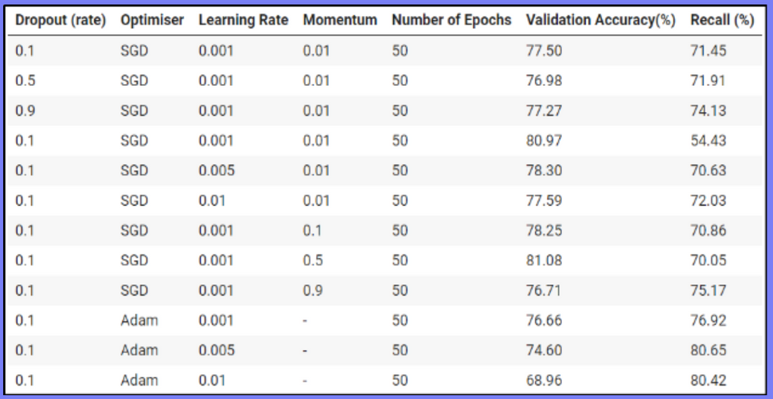
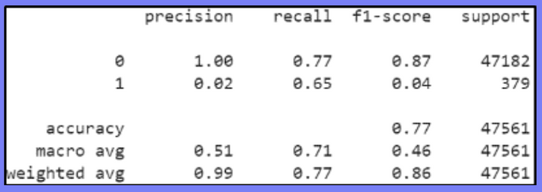
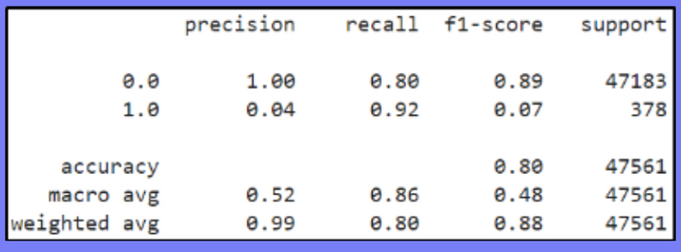
Fire Problem - Results
Work Completed​​
- Data Cleaning and Extraction steps completed​​
- Data Merge and Reverse geocoding tasks​​
- Sequential to Supervised input conversion​​
- LSTM, GRU, SimpleRNN, Random Forest and other Boosting Model hyperparameter tuning and evaluation results​​
- Runs on Latest data In-Progress for a few models​​
​
Work In-Progress​​
- Final model to be identified and tested on latest data ​​
- Results to be shared with the Data Visualization team ​​
​
LSTM Tuning Results
LSTM Results
LSTM : ​
Recall – 77%​​
Accuracy – 77%​
F1-Score – 86%​​
Random Forest :​
Recall – 80%​​
Accuracy – 80%​
F1-Score – 88%​
RF Results

Slide 12
FIRE PROBLEM
WI-FI PROBLEM
PROBLEM STATEMNET
Bushfires are an inconsistent hazard in Geelong City but it does create havoc when it affect the city. With high risk fire regions as close as 80km from Geelong, it is important to predict the possibility of fire in each Geelong and nearby suburb. Use time series prediction algorithms like LSTM, GRU and boosting algorithms​
With variable foot count in and around important hubs in Geelong City where free Wi-Fi is provided, it is important to know the foot count of users to increase/decrease router bandwidth or count as per usage. We plan to incorporate time series prediction exercises and boosting techniques for this task and check performance.

Slide 13




- Wi-Fi Data Extraction ​
- Cleaning and Wrangling
Final Models​
Prediction Steps​
Neural Networks​​
- Long and Short-Term Memory​​
Boosting Algorithms​​
- Random Forest​​
- XGBoost​​
Classic Algorithms ​
- Decision Trees​
- Support Vector Machines​
- K-Nearest Neighbours
- Best k-Clusters​​
- Class Identification ​
- Final Input Creation​
​
Merging Steps​
Prediction Output
- Class Definition​
- Class Balancing​
- Series to Supervised​
- Walkthrough​
- Input Weight
Handling
Processing Steps​

Slide 14
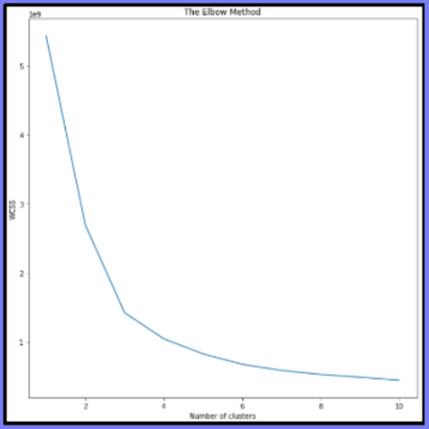
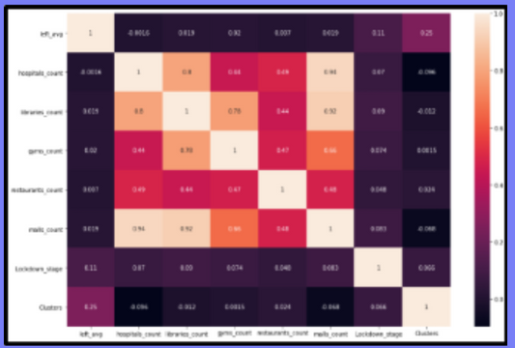
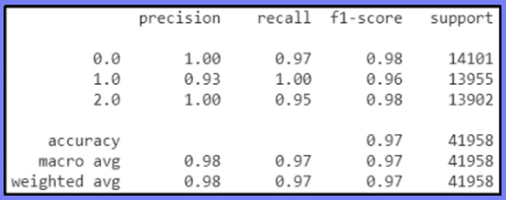
WI-FI Problem - Results
Work Completed​
- Latest data Extracted, Cleaned and prepared for Clustering task​
- Clustering task completed, clusters identified, and new classes created​
- Data prepared for prediction task and PCA idea tested and dropped​
- Data Cleaning and Modelling on Random Forest, K-Nearest Neighbors, Support Vector Machines and Decision Trees Completed ​
- Hyperparameter tuning of identified algorithms
Work In-Progress​
- Final model identification to be tested on latest data​
-Results to be shared with the Data Visualization team
k-Means Elbow Curve​ and Correlation Matrix​
​k-Means Clustering:​
Best k = 3​
Classes : ​(WI-FI usage)
Sparse | Normal | Dense​
​
Random Forest :​
Accuracy – 97%​
F1-Score – 97%​
Recall – 97%​
Precision – 98%​
Evaluation Results - RF​
​

Slide 15
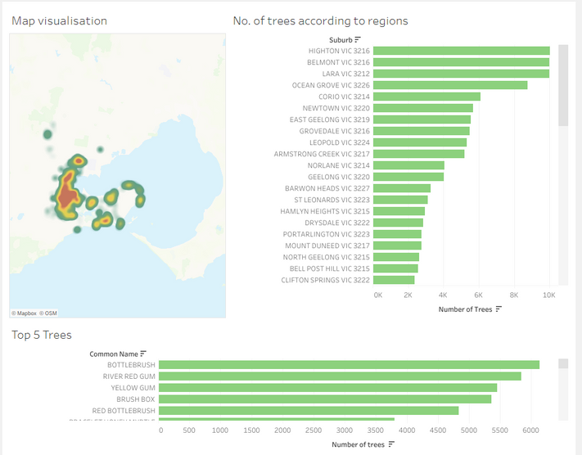
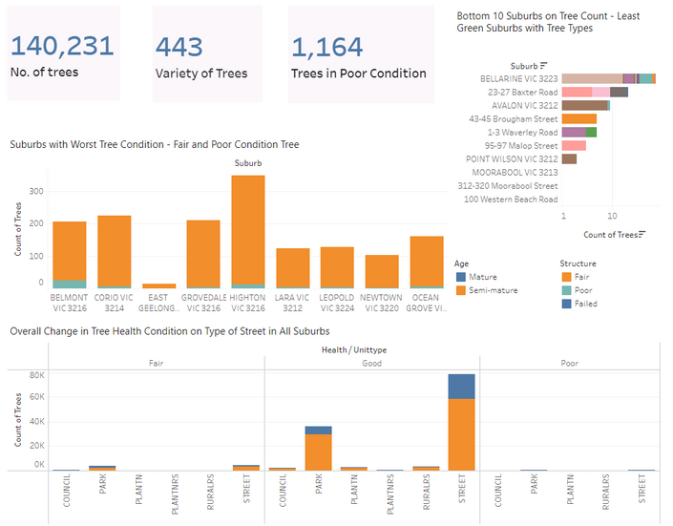
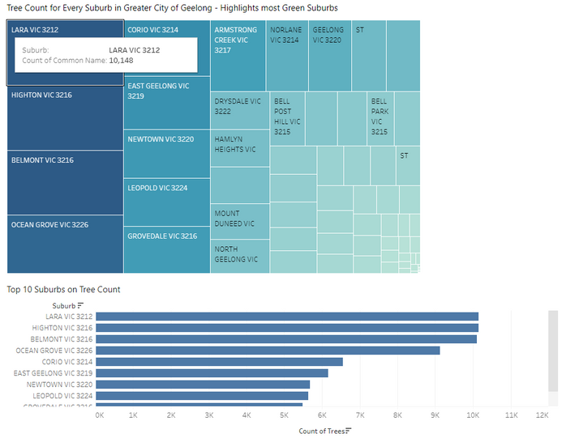
Data Visualization
Before
Work Completed​ - Trees Problem​
- Highlight important results at the top (total tree count , total worst tree condition, etc.) ​
- Sort region form lowest tree count to highest foot count​
- Use tree maps to present total tree count collected in different suburb​
​
Work In-progress​
- Improvement for the tree problem to get better dashboard design and create storytelling.
After

Slide 16
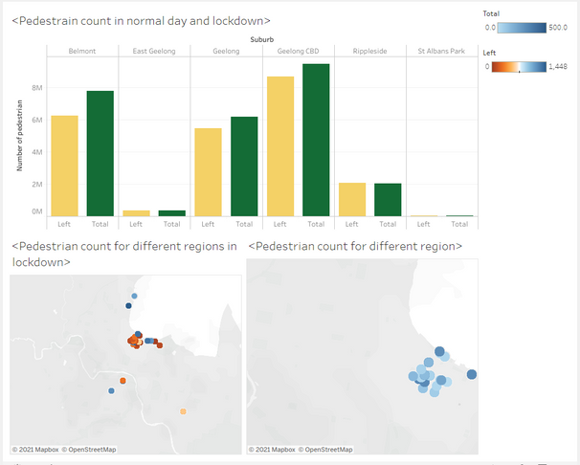
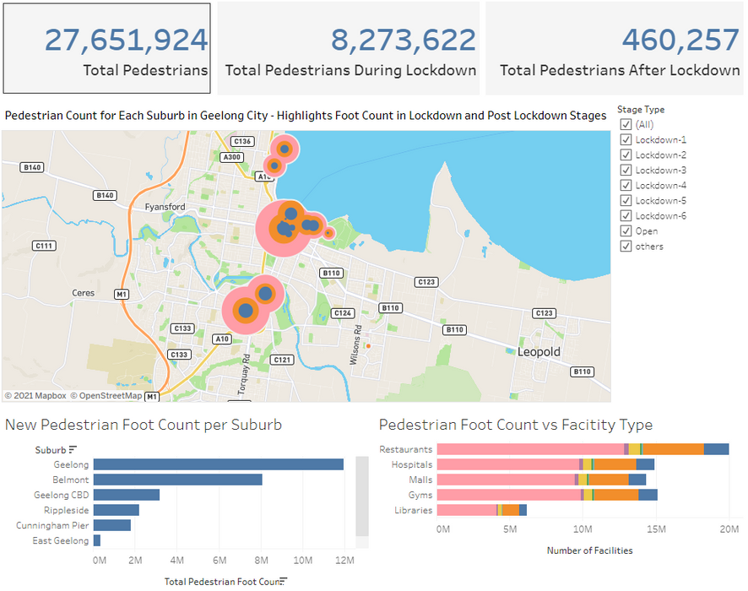
Work Completed​ - Pedestrian Problem​
- Highlight important results at the top (total foot count, total foot count collected during lockdown, etc.)​
- Sort region form highest foot count to lowest foot count.​
- Use stack bar chart to present total foot count collected in different facilities.​
- Added digital display when creating calculated fields for Tree dashboard​
Work In-progress​
- Improvement for the Pedestrian problem to get better dashboard design, and create storytelling.​
Before
After
Work Completed​ - WIFI/Fire Problem​
- According to the sample data set to get map plot for Fire Problem.​
- Wait for the data sets given by other groups about fire problems and Wifi problems, and perform data visualization on these data sets.​
​

Slide 17

Web development
Main page - 6+ Inner pages are created with updated UI/UX
04
Front End design
Features we have added for this iteration
fluid and flexible layout web design offers an optimized browsing experience.
Secures from dummy and duplicate emails
Responsiveness - Adapts to all devices
Mailing System with 2FA
05
01
Adaptive cards can be created to minimize or close. Open to all future platforms.
Newsletter and emergency templates
Handy when sending out the emails to subscribers
Framework based Dashboards
02
06
On request of client, modelled and cleaned dataset can be downloaded.
Dedicated email will get notified with a message
Easy Contact Us Query form
07
Data Download
03

Slide 18
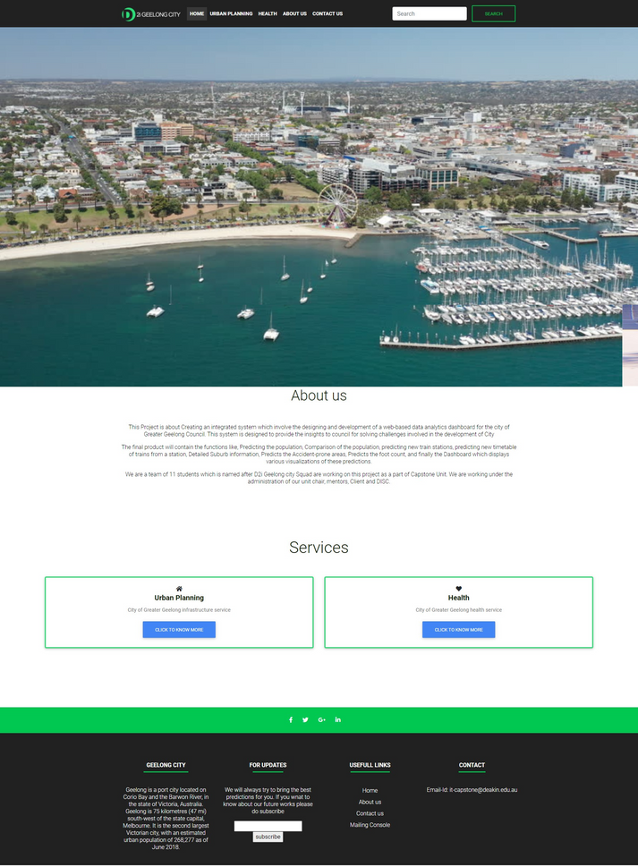
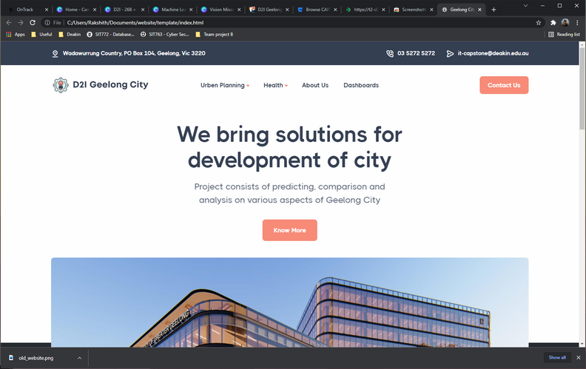

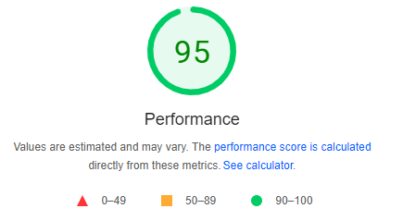
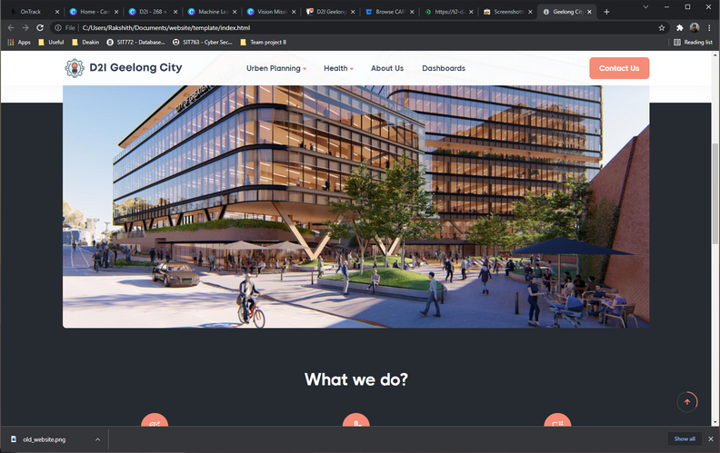
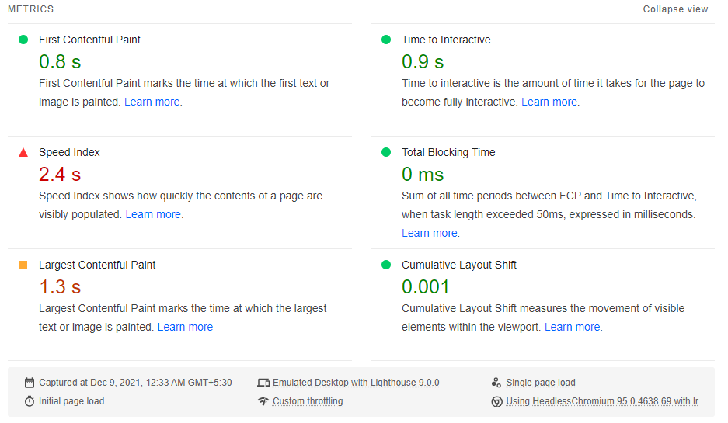
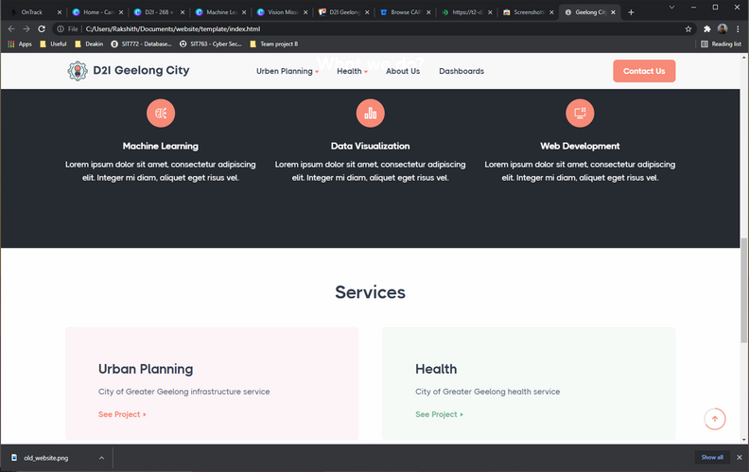

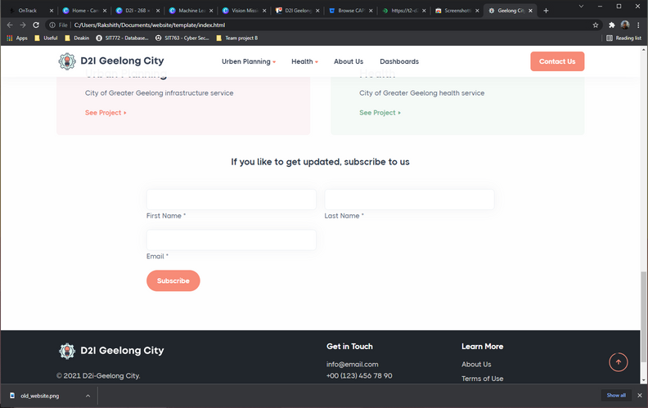
pagespeedinsight.com
Before
After

Slide 19

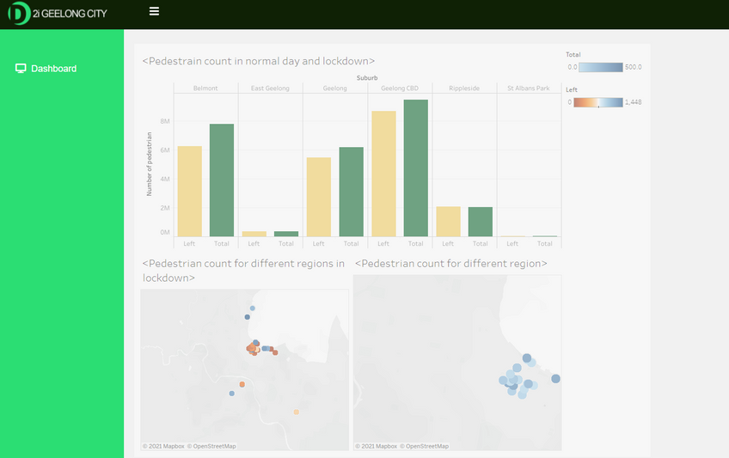
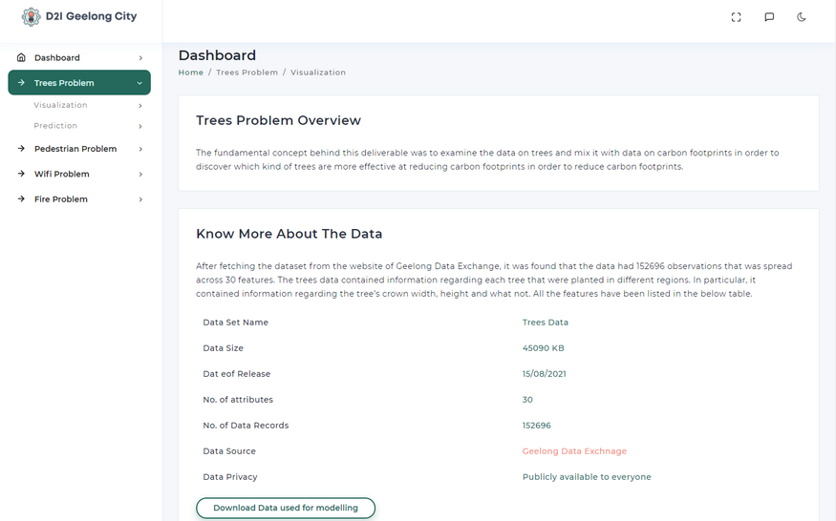
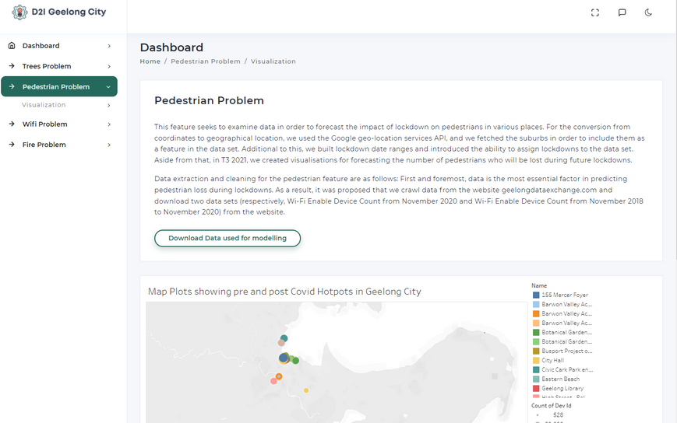

Before
Dashboard Integration
- View all problem on the same page
- Supports Pug and Gulp integration
- Framework can be clubbed with Angular JS and Node.js
- Integrated with Tableau
- Easy download option
After

Slide 20



